Slide 1
Care Opinion……..so what?
Pauline Donnelly
Person Centred Manager
NHS Forth Valley

Slide 2
Introductions
NHS Forth Valley
The Team
NHS Forth Valley has a population of 306,000
6,700 members of staff across NHS Forth Valley
250 members of staff signed up to care opinion of which 226 are responders
During 2023/2024 we received 943 stories an increase of 27% from the previous year
Stories read 91,608
Eilidh Gallagher
Head of Person
Centred Care
Pauline Donnelly
Person Centred Manager
Caroline Logan
Person Centred Coordinator

Slide 3
So what….how we use it
Strategically
Annual Report of Complaints & Feedback
Presented through various Governance structures both locally and at Board level to inform areas of best practice and improvement
Develop Patient Stories using the posts from Care Opinion
Locally
Shared with local teams and staff to showcase their excellent standard, care, commitment and communication
Revalidation – Nursing staff use the feedback to evidence their engagement with patients and families in their revalidation portfolio
Display stories in ward and outpatient areas - demonstrates the good practice and any improvements made as a result of patient feedback.
Social Media - #Feedbak Friday

Slide 4
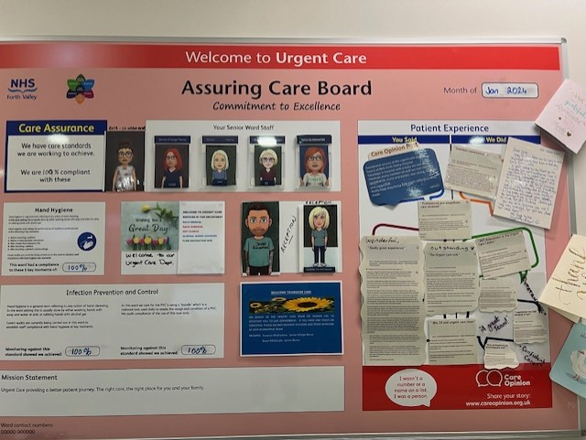
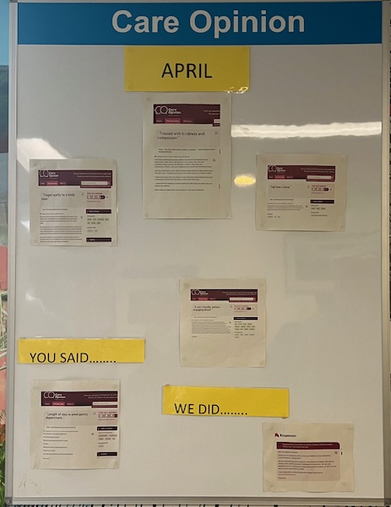
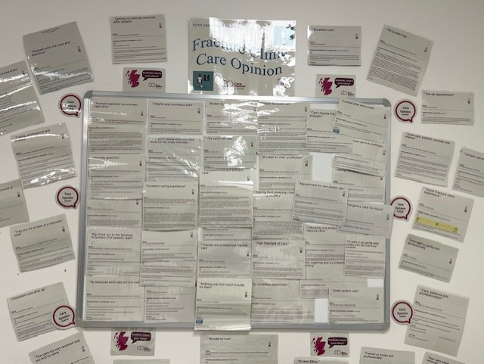
Picture Gallery
Urgent Care
Fracture Clinic
Emergency Department

Slide 5
Staff Experience – Trauma & Orthopaedics Team
“I think that Care Opinion is an excellent platform for service users to provide meaningful feedback.
It makes it easy for patients and their families to offer thanks and feedback direct to point of care. It is useful get constructive criticism to learn from and staff really respond well to positive comments and thanks which is good for department moral!
We use it for patient related feedback for appraisal and also as a tool for staff wellbeing at our daily huddles!”
Kevin McCloskey
Senior Charge Nurse
Trauma & Orthopaedics

Slide 6
Staff Experience – Surgical Skin Team
“We have been using care opinion for a number of years now in the surgical skin team and find it a very useful evaluation tool for our service. We value the experience of our patients, it is a quick and easy method to request information from our patients. We ask for feedback about things we do well and things we could improve upon. Each patient is given a care opinion card when they leave, and we explain that feedback is optional but appreciated.
We use the feedback for service improvement, and also to expand on the areas they say we do well. It allows our managers to see areas where we are excelling and possibly areas that need improvement. It can be a wee wakeup call if there is something that hasn't gone quite so well and it can be good for staff morale when we receive positive feedback. I use the feedback as part of my revalidation process with the NMC also. Hopefully future patients may feel a sense of reassurance if they get a chance to read some of the stories prior to coming in. We find it an easy and rewarding way of engaging with our patients. ”
Kirsteen Easson
Surgical Skin Nurse Practitioner

Slide 7
Staff Experience – Senior Management
“As an organisation, we're really proud to see how many of our staff and patients use Care Opinion to share their stories. Both good and bad, we rely upon the feedback shared to support local level learning across all of our areas. Every story is shared directly with the staff involved and most areas now have their own feedback boards to share their stories across the department.
The teams really benefit from hearing what has gone well, it's exceptionally rewarding to know that you've made a difference to someone's day under what would routinely be stressful circumstances. Equally, it offers us essential opportunities to improve if we know that things haven't gone as well as we would have hoped. Sharing these stories directly with the teams involved offers the right person the opportunity to respond quickly to resolve any issues”

Slide 8
So….what’s next
Continue to grow the Care Opinion family across NHS Forth Valley
Evidence the learning and changes made through the tools provided by Care Opinion
Demonstrating the benefits of care opinion to staff and patients/families/carers
Promoting the benefits of Care Opinion to show learning and good practice
Engage with young people to gather their views and stories, ensuring their voices are heard.

Slide 9
Questions

