Slide 1
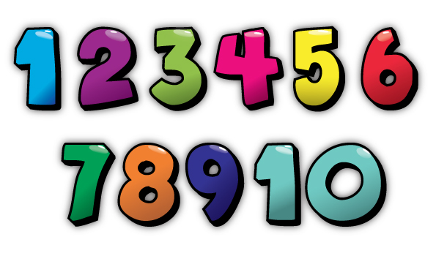
Evaluation – Building a Logic Model?
Sarah Russell
Head of Research, Hospice UK
Visiting Fellow, University of Southampton
Editor: European Journal of Palliative Care
Twitter: #coTeams @learnhospice

Slide 2
Building an Evaluation Logic Model together
What is a Logic Model?
A conceptual framework for service evaluation of projects and programmes used widely in health and social care settings .
A visual map which maps a project e.g.
Inputs, activities, outputs, outcomes & impact
Internal and external factors that may affect the success of a project
Wider considerations and assumptions
See https://midlandsandlancashirecsu.nhs.uk/
Twitter: #coTeams @learnhospice

Slide 3
Logic Model Includes:
Inputs
Outputs
Short term outcomes
Activities
Impact/long term outcomes
Unit of measurement (methods) and approach (methodology)
Twitter: #coTeams @learnhospice

Slide 4
Our project influenced by Action Research: a family of research methodologies which pursue action and research outcomes at the same time. Is emergent. Cyclic nature allows responsiveness. Cyclic, participative, reflective and qualitative
PEOLC Logic Model Template
Goal/Aim – what is (y)our overall aim or goal?
Objectives – what are the specific objectives or goals we/you wish to achieve and by when?
Inputs What is needed to make this successful and why are you doing it? | Activities What activities are needed to make this successful? | Outputs If activities occur, what is produced which demonstrates success? | Intermediate outcomes What difference is made in the short term? | Longer Term Outcome/Impact What difference is made in the longer term?
 | Process Evaluation…. Was it implemented effectively? |  | Outcome Evaluation… What difference has it made?
 | What units of measurement can be used?
Internal/External Factors and Considerations that may affect programme
Assumptions about the programme
Evaluation Methodology (e.g. Action Research) and Methods (Mixed)
Twitter: #coTeams @learnhospice

Slide 5
PEOLC Logic Model Template
Goal/Aim – what is (y)our overall aim or goal?
Objectives – what are the specific objectives or goals we/you wish to achieve and by when?
Inputs What is needed to make this successful and why are you doing it? | Activities What activities are needed to make this successful? | Outputs If activities occur, what is produced which demonstrates success? | Intermediate outcomes What difference is made in the short term? | Longer Term Outcomes/Impact What difference is made in the longer term?
 | Process Evaluation…. Was it implemented effectively? |  | Outcome Evaluation… What difference has it made?
 | What units of measurement can be used?
Evidence of need Programme development Application criteria & assessment Care Opinion platform etc | Call for applications Applications assessed Places offered Induction day Reference group invited CoP evaluation Team activity etc | Induction day evaluation CoP resources Evaluation of CoP Evaluation of team activity Measurement of activity, satisfaction, quality, relevance and effectiveness | Practical implementation plan and resource for current and future sites
 |  |  | Participants reporting on the difference that PEOLC has made on their patient care activity. Individual team outcomes (see own applications) | Fidelity (the degree of exactness with which something is copied or reproduced) of original model tested in 10 sites
Design and decide together unit of, frequency of measurement, what (y)our outcomes maybe…

Slide 6
Evaluation Principles… Mixed Methods….
Utilise data that you are already collecting
Use Care Opinion Platform to collect data
Gather experience of as well as number of…
Influenced by Action Research approach i.e. Cyclic, participative, reflective and qualitative.
Twitter: #coTeams @learnhospice

Slide 7
Evaluation
Sarah Russell
Head of Research, Hospice UK
Visiting Fellow, University of Southampton
Editor: European Journal of Palliative Care

