Slide 1
A Start Up Guide
Notes:
This is a short guide to Care Opinion which is a not for profit social enterprise founded 12 years ago. CO is the leading independent feedback platform committed to giving the public a voice and providers the opportunity to respond.

Slide 2
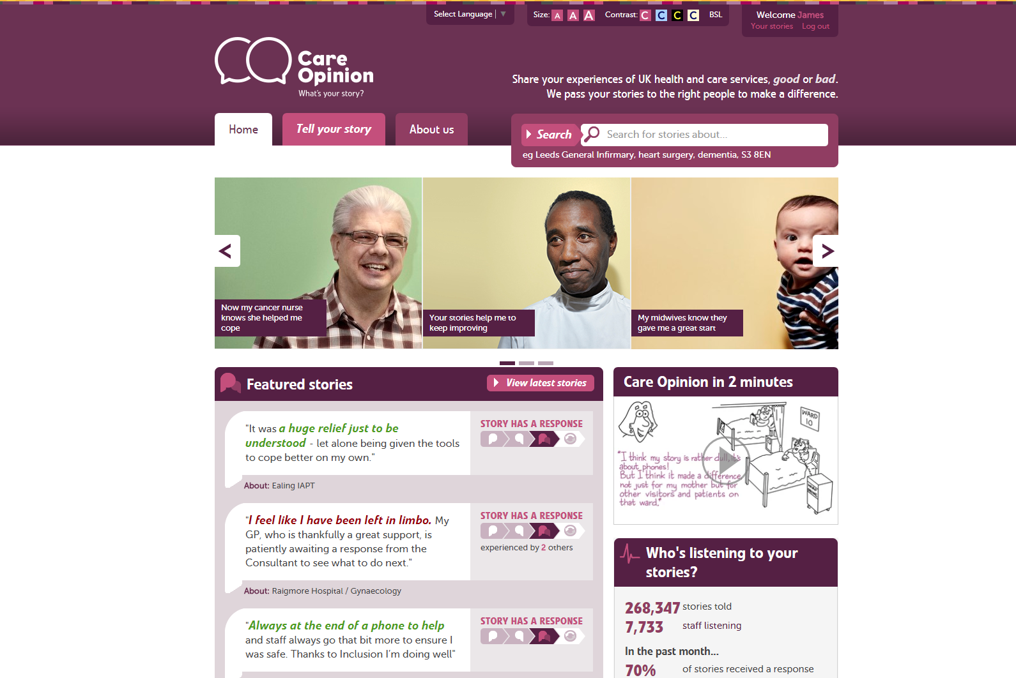

Slide 3
The Care Opinion Mission
To provide an online platform so that:
people can share honest feedback easily and without fear
stories are directed to wherever they can help make a difference, and
everyone can see how and where services are listening and changing in response

Slide 4
Benefits
For service users, carers and families
Safe, simple, transparent feedback loop
Issues resolved, service changes
For staff teams
Learning, Quality Improvement, morale, culture
For the wider organisation
Transparency, reputation, complaints
Notes:
Does not replace formal complaints but authors sometimes feedback on the site as an alternative. Postings are public and seen by a wide range of stakeholders. There is a staff resource pack to help with posting generation as well as a range of materials. Please ask the subscriber support team.

Slide 5
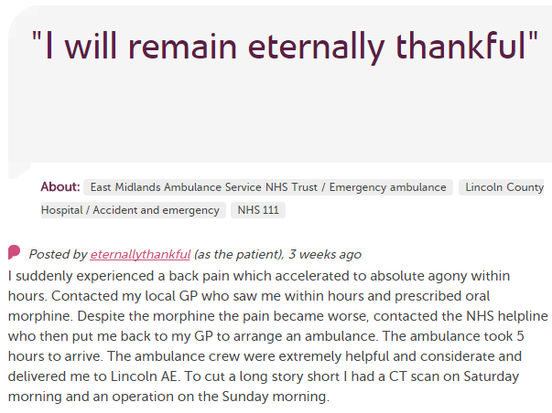
In each provider
Moderation
Service staff
Different Staff Teams
User exp, comms, complaints…
Alerting
CEO
Commissioners
Nursing, AHP students
Healthwatch
Researchers
Other Stakeholders
CQC
Notes:
Stories come in and all are moderated. Alerts can go out then to a range of stakeholders and interested parties. Stories are also tweeted out and shared on social media by CO and provider organisations.

Slide 6
Keeping Staff and Authors Safe:
All stories and responses are read by an expert team of moderators before they are made public
Staff are not named as part of any negative comments and details are removed to prevent jigsaw identification
Care Opinion have Safeguarding and Vulnerable Persons policies as part of their robust moderation policy and processes
Care Opinion team are always there to discuss any queries-just e mail or phone
Notes:
Care Opinion has a highly evolved moderation policy that is informed by legal advice.

Slide 7
330,000
stories
7,000
staff + students listening
stories read
89 million
times
100,000
visitors per week

Slide 8
What authors say:
She really does deserve praise, and I am grateful for this site where staff can be highlighted for doing a great job
I wasn’t sure if I was doing “the right thing” by posting on Care Opinion, but I am so glad I did, hopefully lessons will be learned from my experience
I feel empowered and understood and believed and respected
A necessary route for voicing opinion but without making a formal complaint

Slide 9
How does it work in practice?

Slide 10
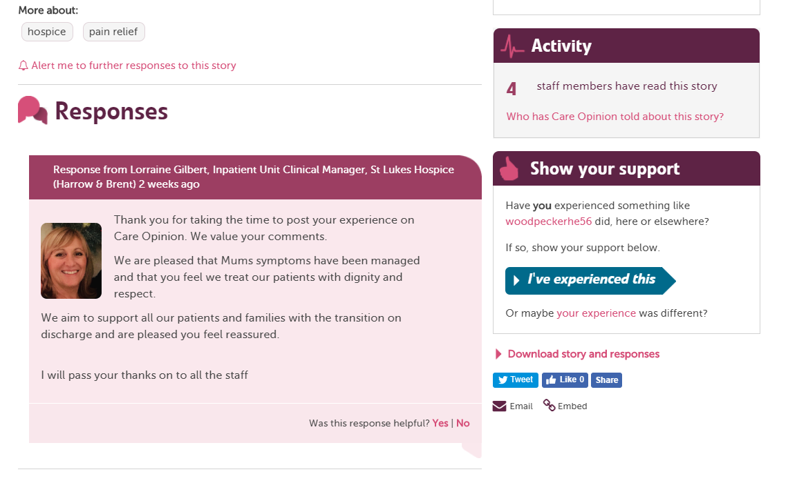

Slide 11
Direct Ask Cards are for staff to give to patients/families with a “direct ask” to share their feedback about their experience on Care Opinion. These can be given: - at the start of an episode of care or treatment - or at the end - in clinic - to get feedback in a particular area - or when arriving at service.

Slide 12
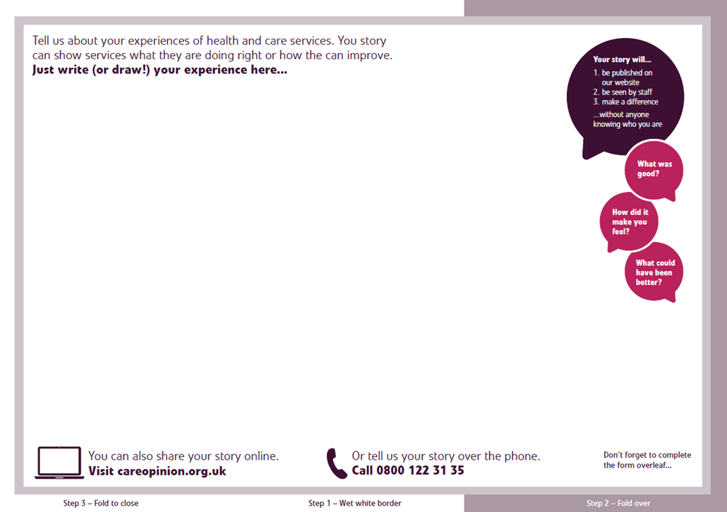

Slide 13
Next Steps and Support
Make sure you are set up on the subscription
Look around the site, try telling your own story about being a patient or relative
Discuss with colleagues your role with feedback, and how to generate stories
Support is available on the CO site, from your service manager, from the subscriber support team at Care Opinion

Slide 14
Subscriber support
Tel: 0114 281 6256 Sheffield Office
Tel: 01786 235984 Stirling Office
Email: info@careopinion.org.uk

